Slide 1
Local Thresholding Method
CSIE 410285034 蕭勝興

Slide 2
Original Local Thresholding Problems
Initial Threshold value
Scan order

Slide 3
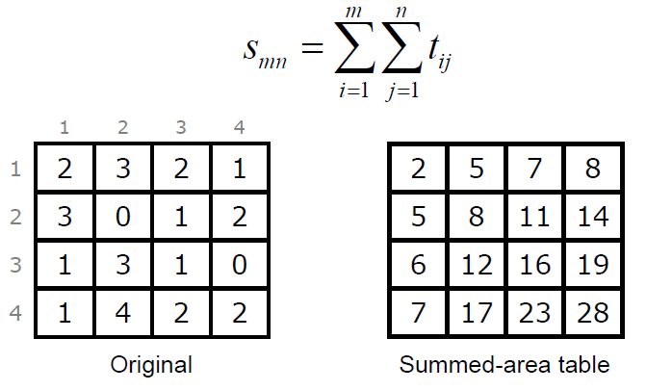
Adaptive Thresholding Using the Integral Image
Compare adjacent areas
In linear time O(n) per rectangle
Bradley, D., Roth, G. 2007. Adaptive Thresholding Using Integral Image. Journal of Graphics Tools. Volume 12, Issue 2.pp. 13-21.
achieve constant time O(1) after preprocessing
http://people.scs.carleton.ca/~roth/iit-publications-iti/docs/gerh-50002.pdf

Slide 4
Adaptive Thresholding Using the Integral Image
(2,2) 2+3+3+0=8
http://people.scs.carleton.ca/~roth/iit-publications-iti/docs/gerh-50002.pdf

Slide 5

Adaptive Thresholding Using the Integral Image
http://people.scs.carleton.ca/~roth/iit-publications-iti/docs/gerh-50002.pdf
Notes:
The author give two formula

Slide 6
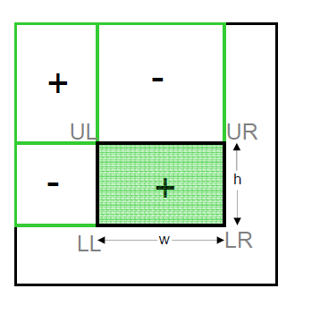

Adaptive Thresholding Using the Integral Image
Average = $\frac{\text{LR}\text{−}\text{UR}\text{−}\text{LL}\text{+}\text{UL}}{w∗h}$
http://people.scs.carleton.ca/~roth/iit-publications-iti/docs/gerh-50002.pdf

Slide 7
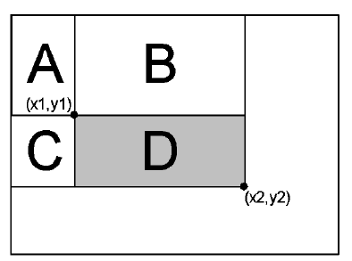
Adaptive Thresholding Using the Integral Image
sum over rectangle D:
LR-UR-LL+UL
=>(A+B+C+D)-(A+B)-(A+C)+A
We get the average and compare with the threshold
http://people.scs.carleton.ca/~roth/iit-publications-iti/docs/gerh-50002.pdf

Slide 8
Adaptive Thresholding Using the Integral Image
Get a summed-area table
Traverse all the pixels
Using these pixels as the center point
Calculate the average of the S * S size rectangle
Compared current threshold
http://people.scs.carleton.ca/~roth/iit-publications-iti/docs/gerh-50002.pdf

Slide 9
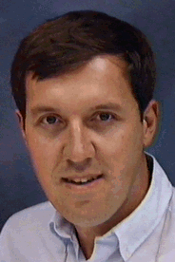
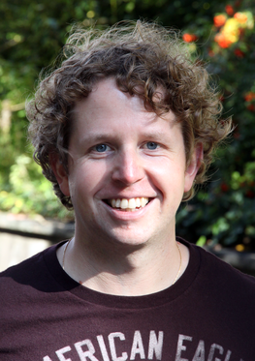
Adaptive Thresholding Using the Integral Image
“Our technique is suitable for processing live video streams at a real-time frame-rate, making it a valuable tool for interactive applications such as augmented reality. “
http://people.scs.carleton.ca/~roth/iit-publications-iti/docs/gerh-50002.pdf

Slide 10
DEMO

